Slide 1
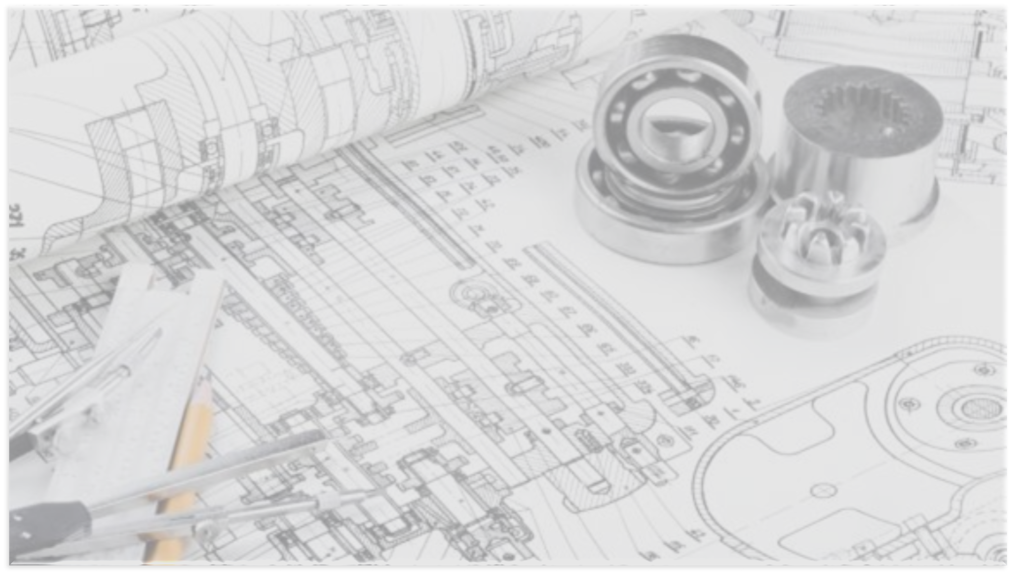



A New Concept to
Store Cement
www.intechnikusa.com
Tel.: +1 469 531 7533
lsucre@intechnikusa.com
2021 IEEE-IAS/PCA Cement Conference

Slide 2
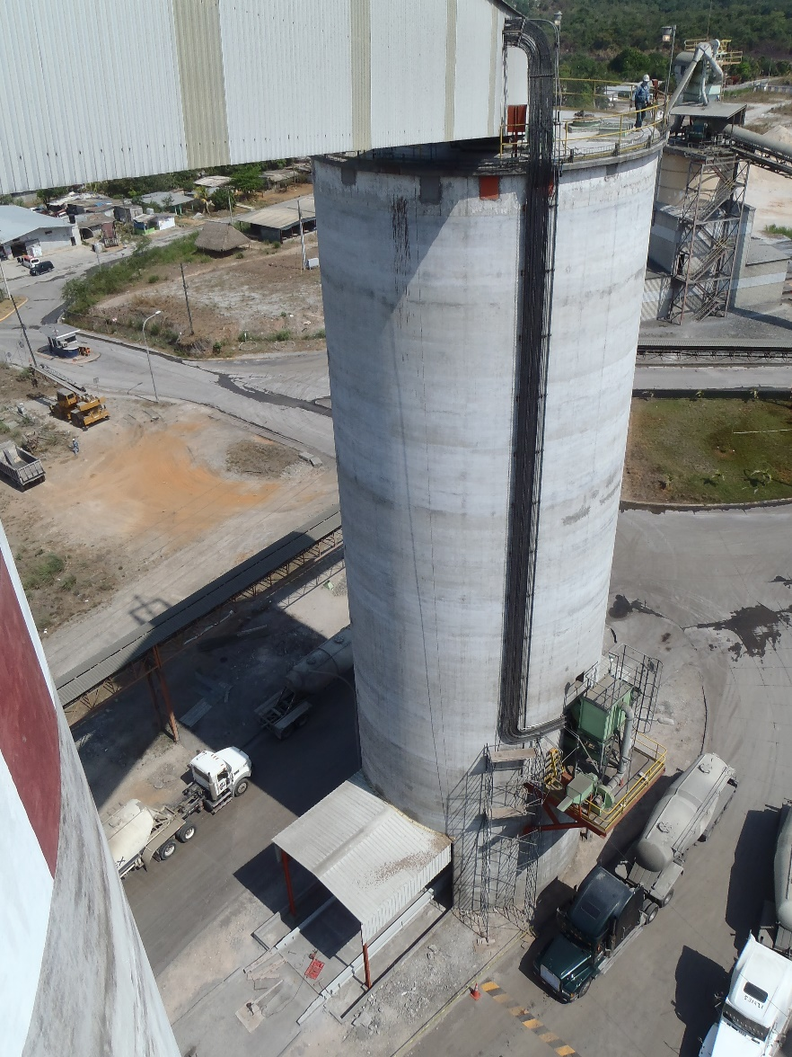
Cement Storage System
Selection Criteria
Storage capacity
Through put capacity
Available space and site geometry
Soil conditions
Capital available
Available facilities

Slide 3
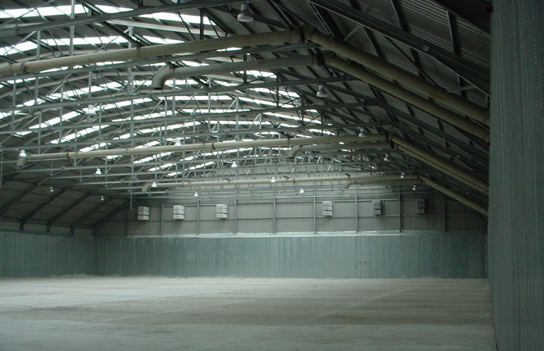
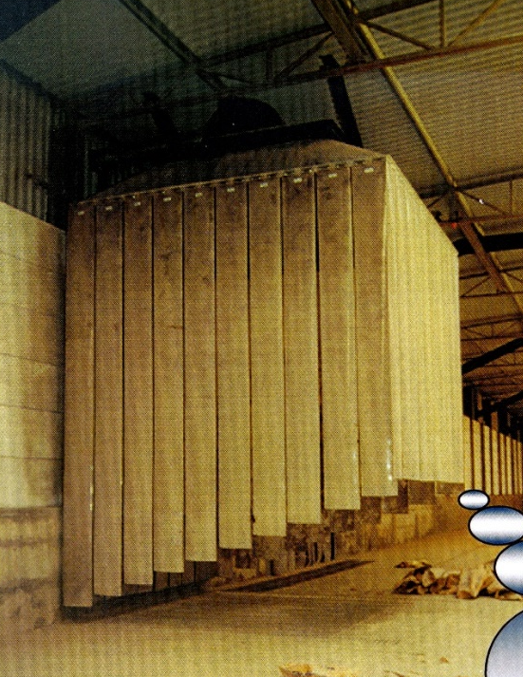
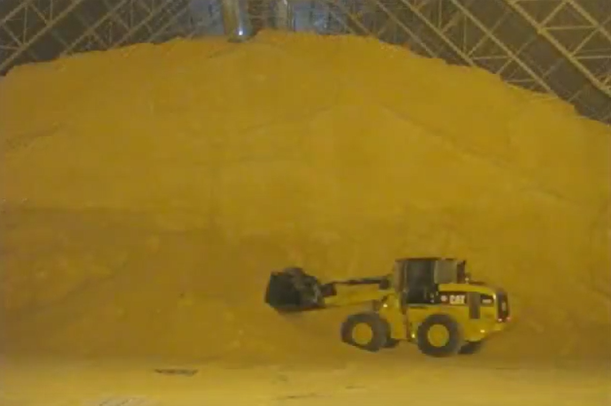
When is it recommended to use a
Horizontal Storage solution?
Main Challenge:
An efficient reclaiming system
To store amounts < 65,000 Tons of cement
To avoid costly civil works
Low capital investment
Existing warehouse is available
There are large areas at the plant or terminal
Low material storage height

Slide 4
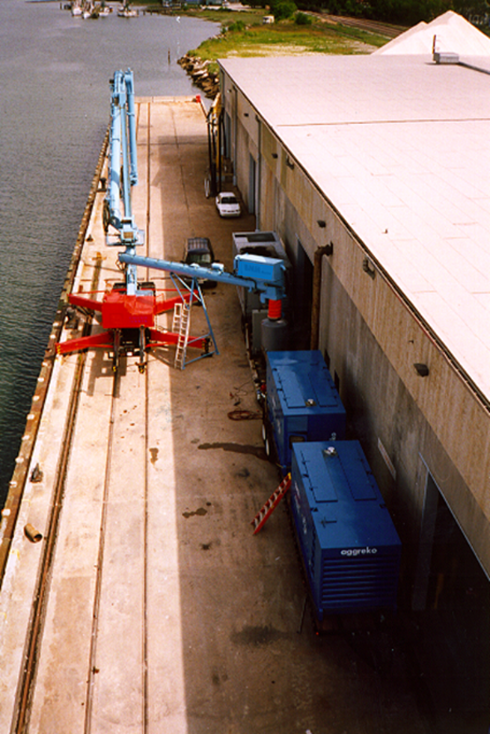
Overcoming
Flat Storage Challenges
Design premises new Flat Storage system:
To use existing warehouses
The system should be fully automated
Easy to install and dismantle
Minimum personnel to operate
Possible to store different types of cement
Storage system should be ecological friendly
Reduce the aeration on the warehouse floor
Storing and reclaiming cement of up to 300 tph cap
To avoid the use of front loaders to perform the reclaiming operations.

Slide 5
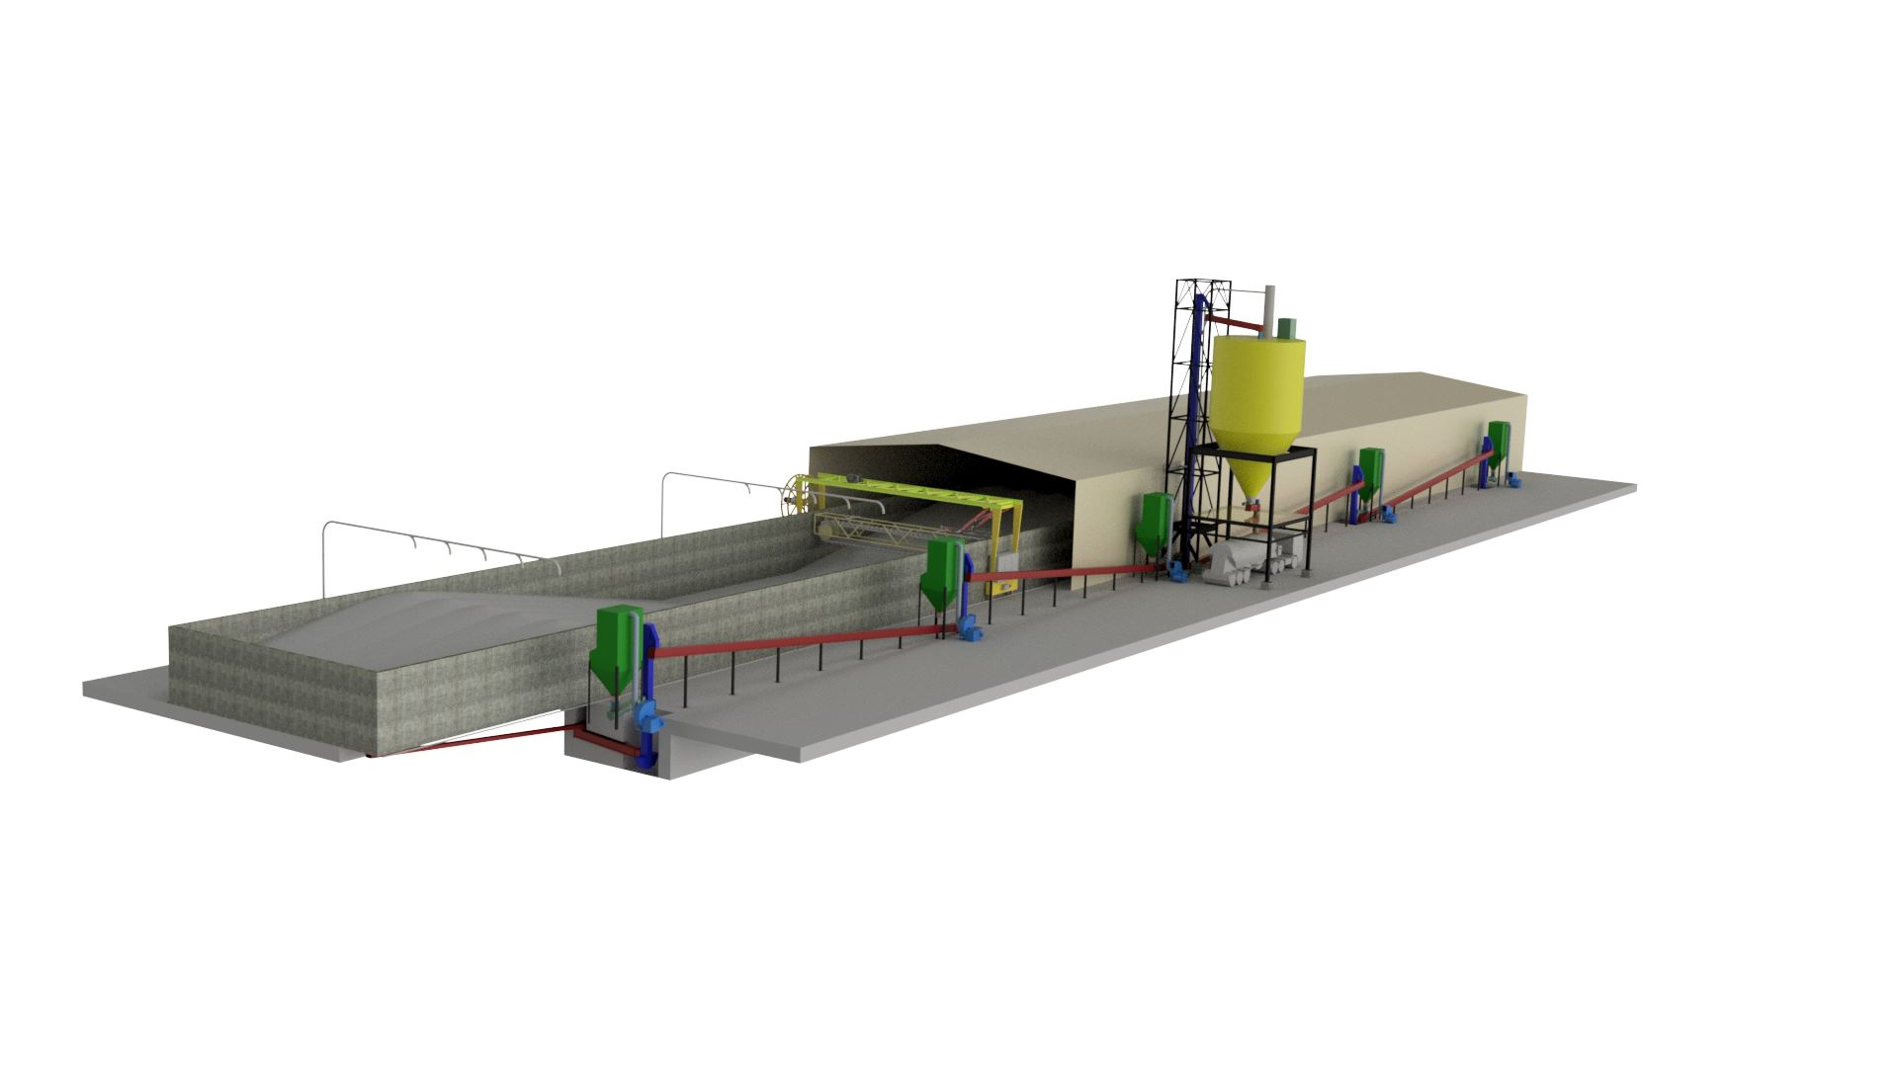
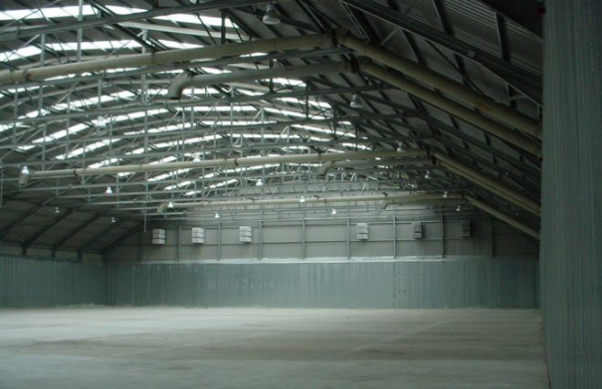
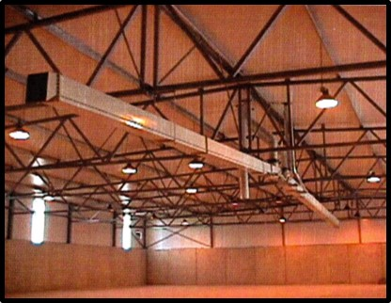
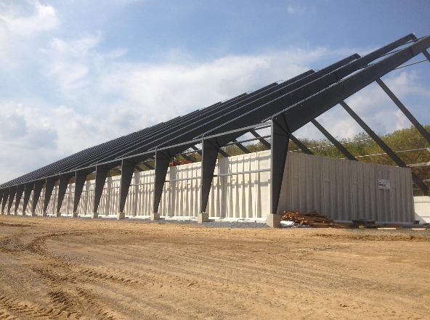
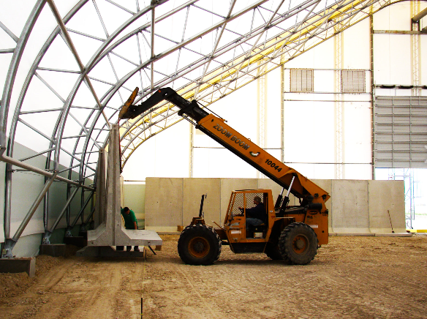
New Concept
Cement Horizontal Storage
Main Components
Stacking equipment:
Conveying pipe.
Two-ways Valves.
Pneumatic butterfly valves.
Ancillary equipment and control system:
Service compressor, including air compressed pipe.
Set of dust Collectors, including dedusting pipe and return screw conveyor and rotary valve.
MCC and HMI control system.
Dust Tight Enclosure
Reclaiming system:
Cement "U" reclaimer.
Open aeroslides, aeration blowers.
Transition enclosed aeroslides from open aeroslide to screw conveyor or bucket elevator.
Slide gates.
On-off flow control gate.
Dispatch system:
Cement Hopper.
Truck Loading spout.
Eventually the dispatch system may include the installation of a packing unit.
The dispatch system may be supplied totally mobile.
System may be also supplied with a truck scale.
Retaining Walls
Vertical screw conveyors or bucket elevators.
Enclosed aeroslide to convey cement to the dispatch system.
Aeration fans for enclosed aeroslides .

Slide 6
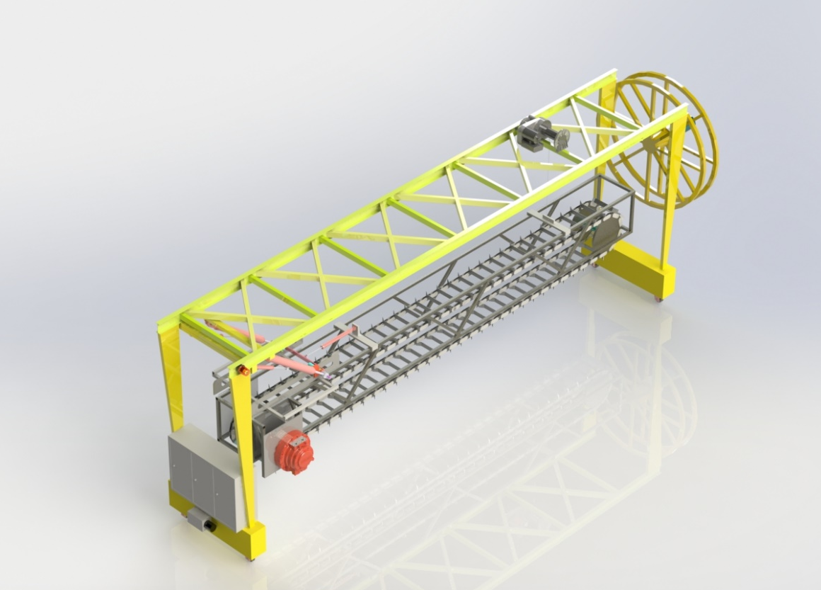
“U” Reclaimer in lieu of Front Loaders
Cable Reel
Reclaiming Arm
MCC and PLC Unit
Hydraulic Power Unit
Reclaiming Arm Hydraulic Motor
Reclaiming Arm Winch with Hydraulic Motor
Hydraulic Cylinders
Traveling motors

Slide 7
New Cement Horizontal Storage Concept
Power Consumption

Slide 8
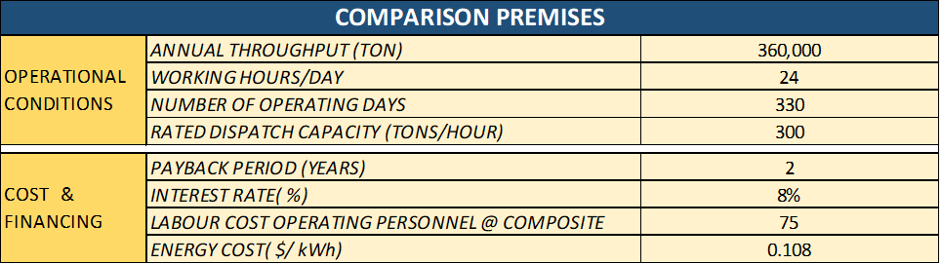
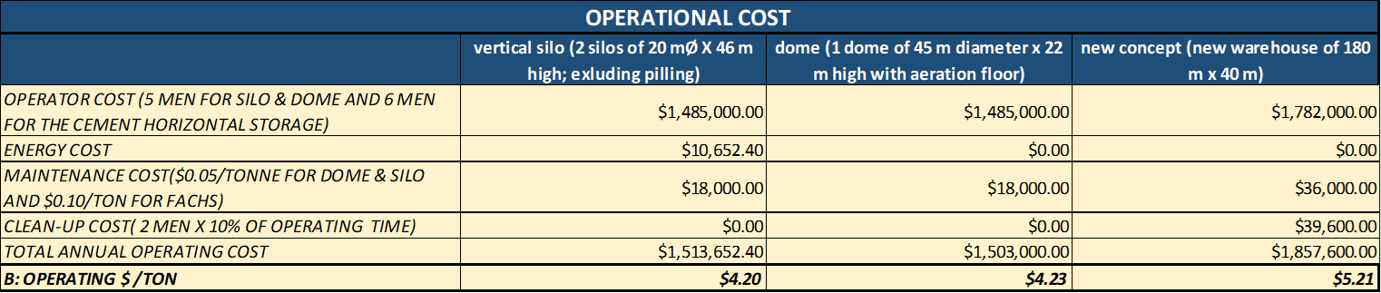
Cost Comparison

Slide 9
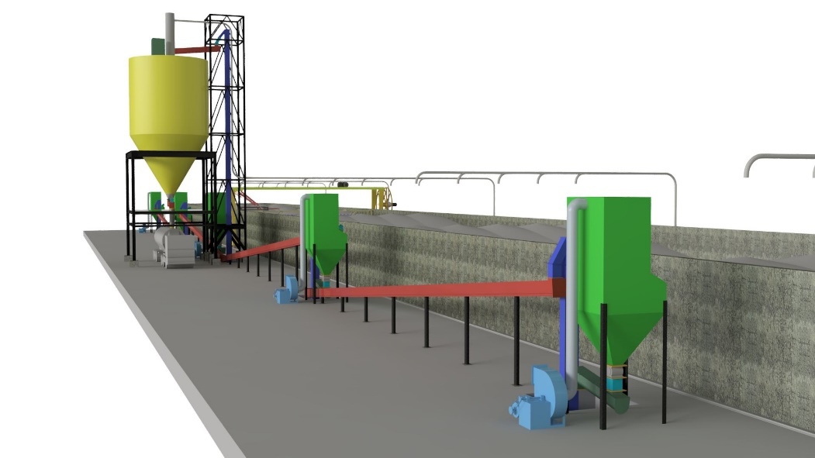
Conclusions
A Cement horizontal storage with automated stacking and reclaiming System has the following features:
Unlimited storage capacity
Ideal for marine terminals
Easy to install and easy to dismantle
Storage of more than one type of cement
Other products different than cement
No require the use of front loaders
Short construction time
It is possible to use existing warehouses
Low OPEX
Low CAPEX
Low-cost option to compete in efficiency with silos and dome storage facilities

Slide 10
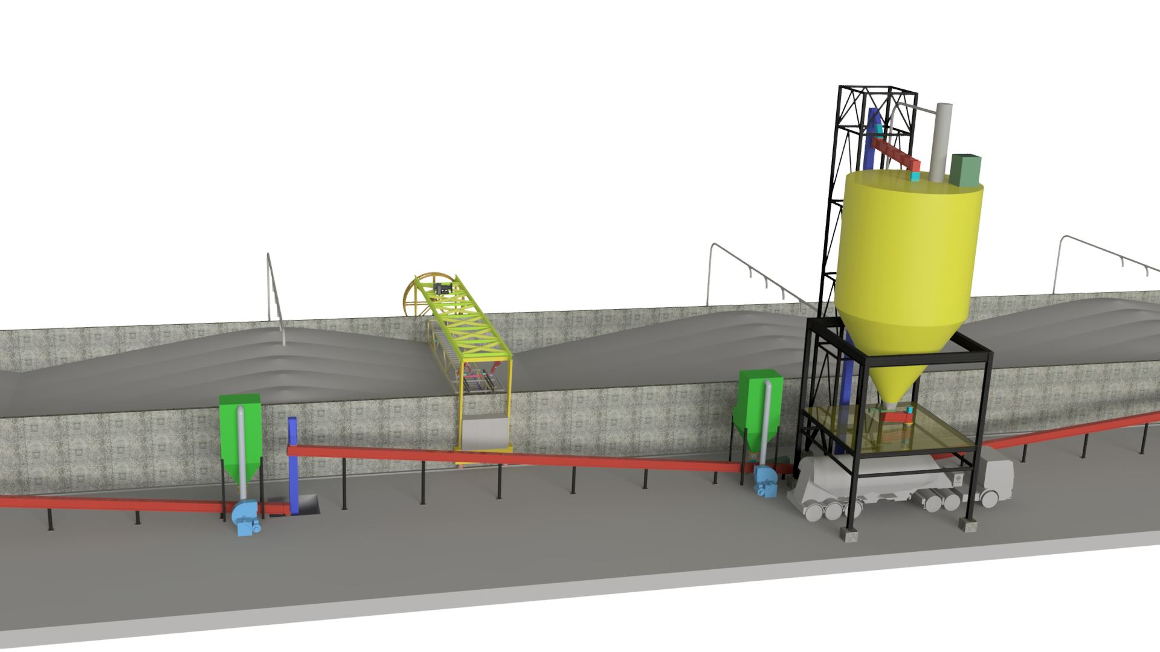
Thanks!

